Slide 1
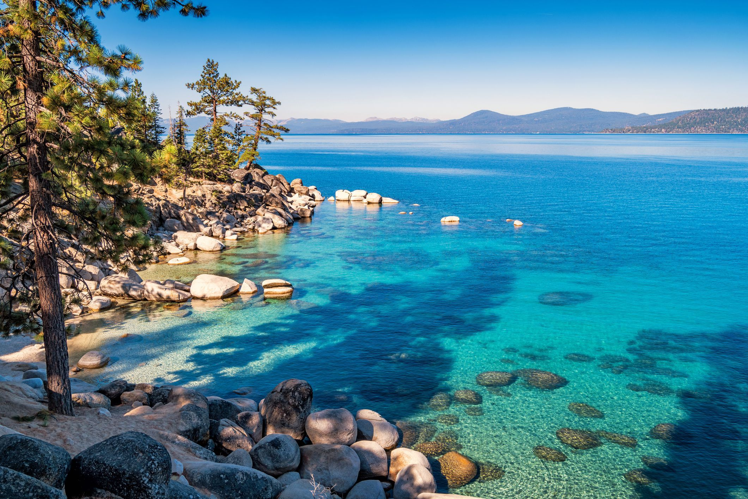


Terms Extension Opportunity Assessment
July 2024

Slide 2
Situation Summary
Situation Summary for American Water Company
We understand that American Water is looking to optimize its working capital position with Taulia’s holistic Working Capital Management platform.
Taulia analyzed $X USD spend & Y supplier relationships across American Water’s global spend file to highlight the working capital trapped within American Water’s supply chain.
Highlights:
* Working Capital Opportunity:
* Total potential working capital within American Water’s existing supply chain is ~$250M based on the harmonized extension scenario.
* Impact to Discounts:
* Significant discount potential with peak liquidity demand at APR 6 with 1.4M gross yield.
* Industry Analysis:
* Taulia expects American Water should be able to generate $X M across its top-10 largest supplier industry groups.
By aligning payment terms with industry norms and leveraging Taulia’s platform, American Water can unlock significant working capital and efficiency gains.
© 2023 Taulia LLC. Confidential information. Do not distribute.

Slide 3
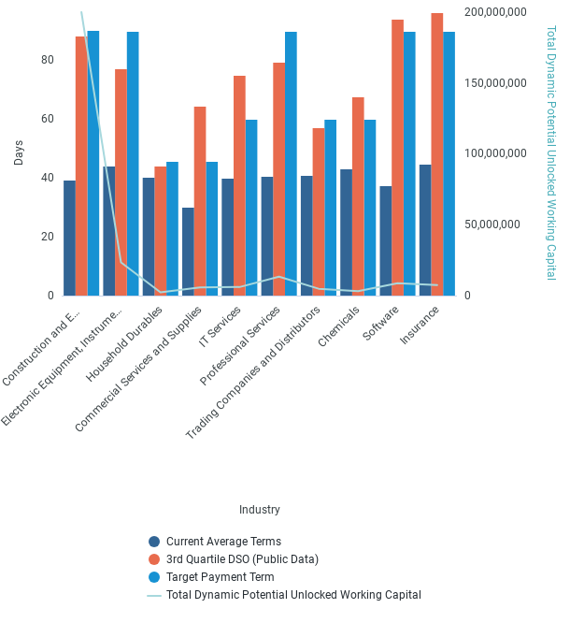
Industry Term Comparison
© 2023 Taulia LLC. Confidential information. Do not distribute.

Slide 4
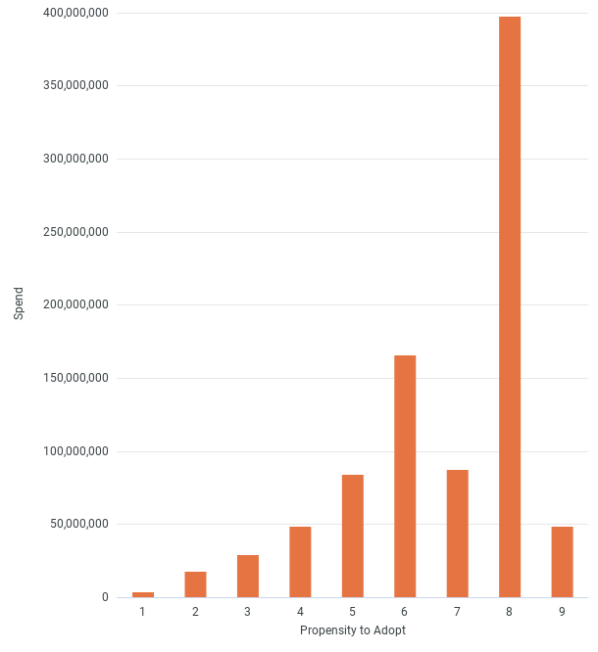
Card Adoption
© 2023 Taulia LLC. Confidential information. Do not distribute.

Slide 5
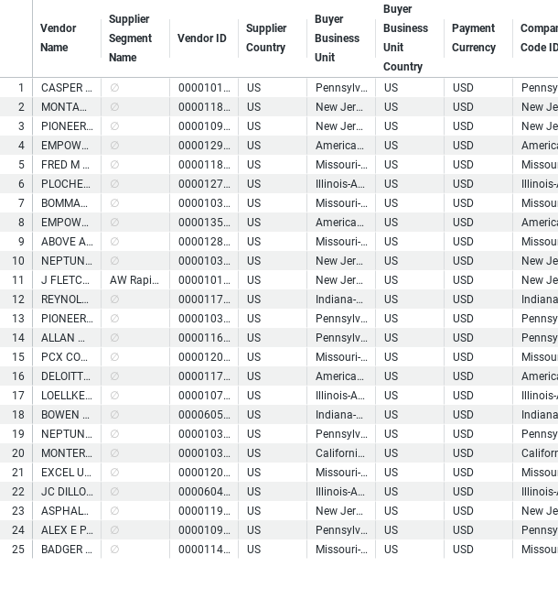
Top WC Potential Suppliers
© 2023 Taulia LLC. Confidential information. Do not distribute.

Slide 6
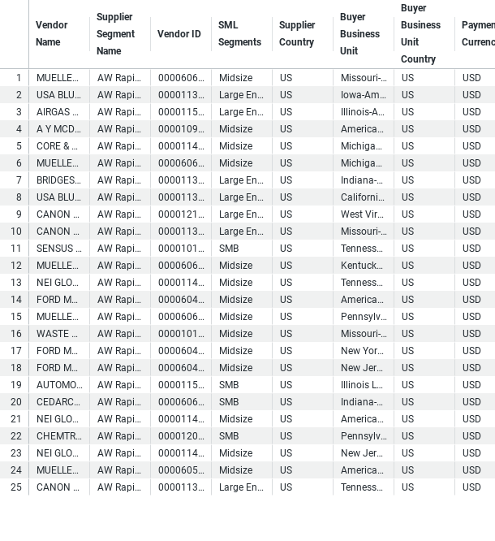
Buyer - Payables Planner Supplier List
© 2023 Taulia LLC. Confidential information. Do not distribute.

Slide 7
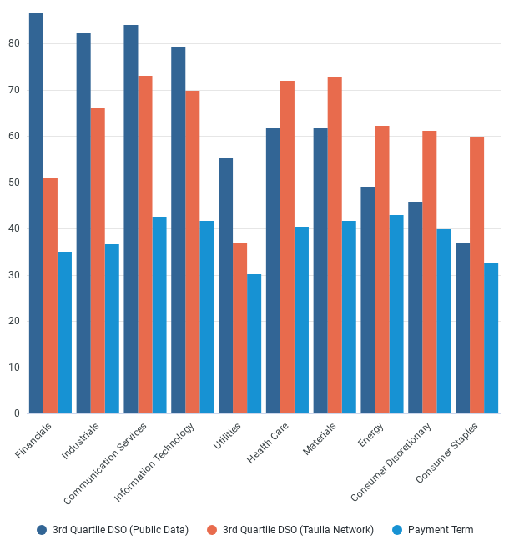
Supplier Payment Terms Comparison
© 2023 Taulia LLC. Confidential information. Do not distribute.

Slide 8
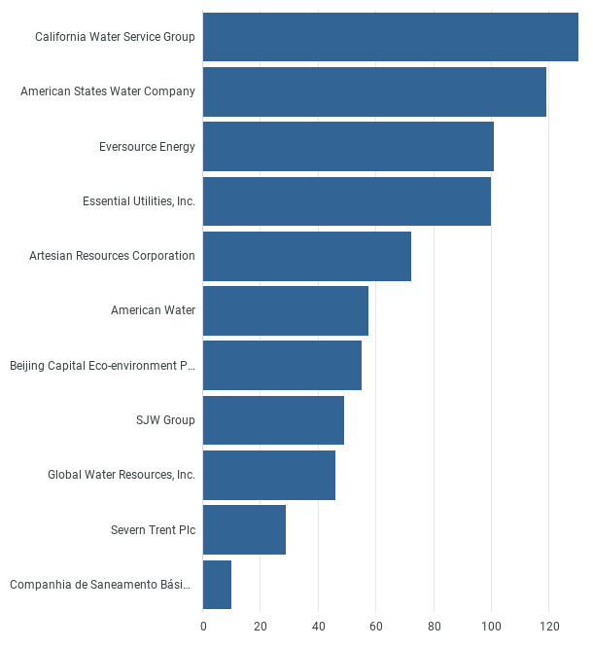
Peer DPO
© 2023 Taulia LLC. Confidential information. Do not distribute.

Slide 9
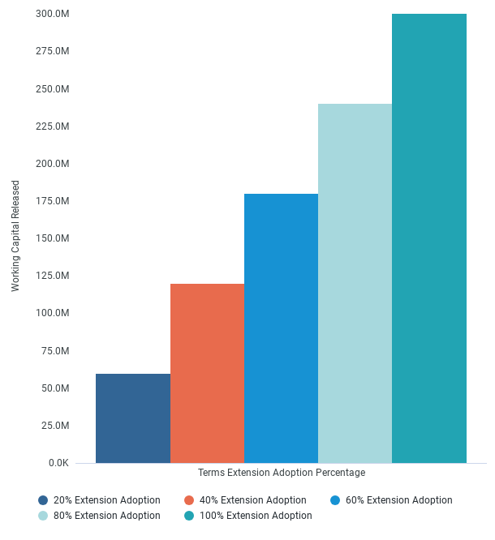
Working Capital Released
© 2023 Taulia LLC. Confidential information. Do not distribute.

